Slide 1
The Lost Art of Good Object Design
Devlin Liles, President - Houston

Slide 2
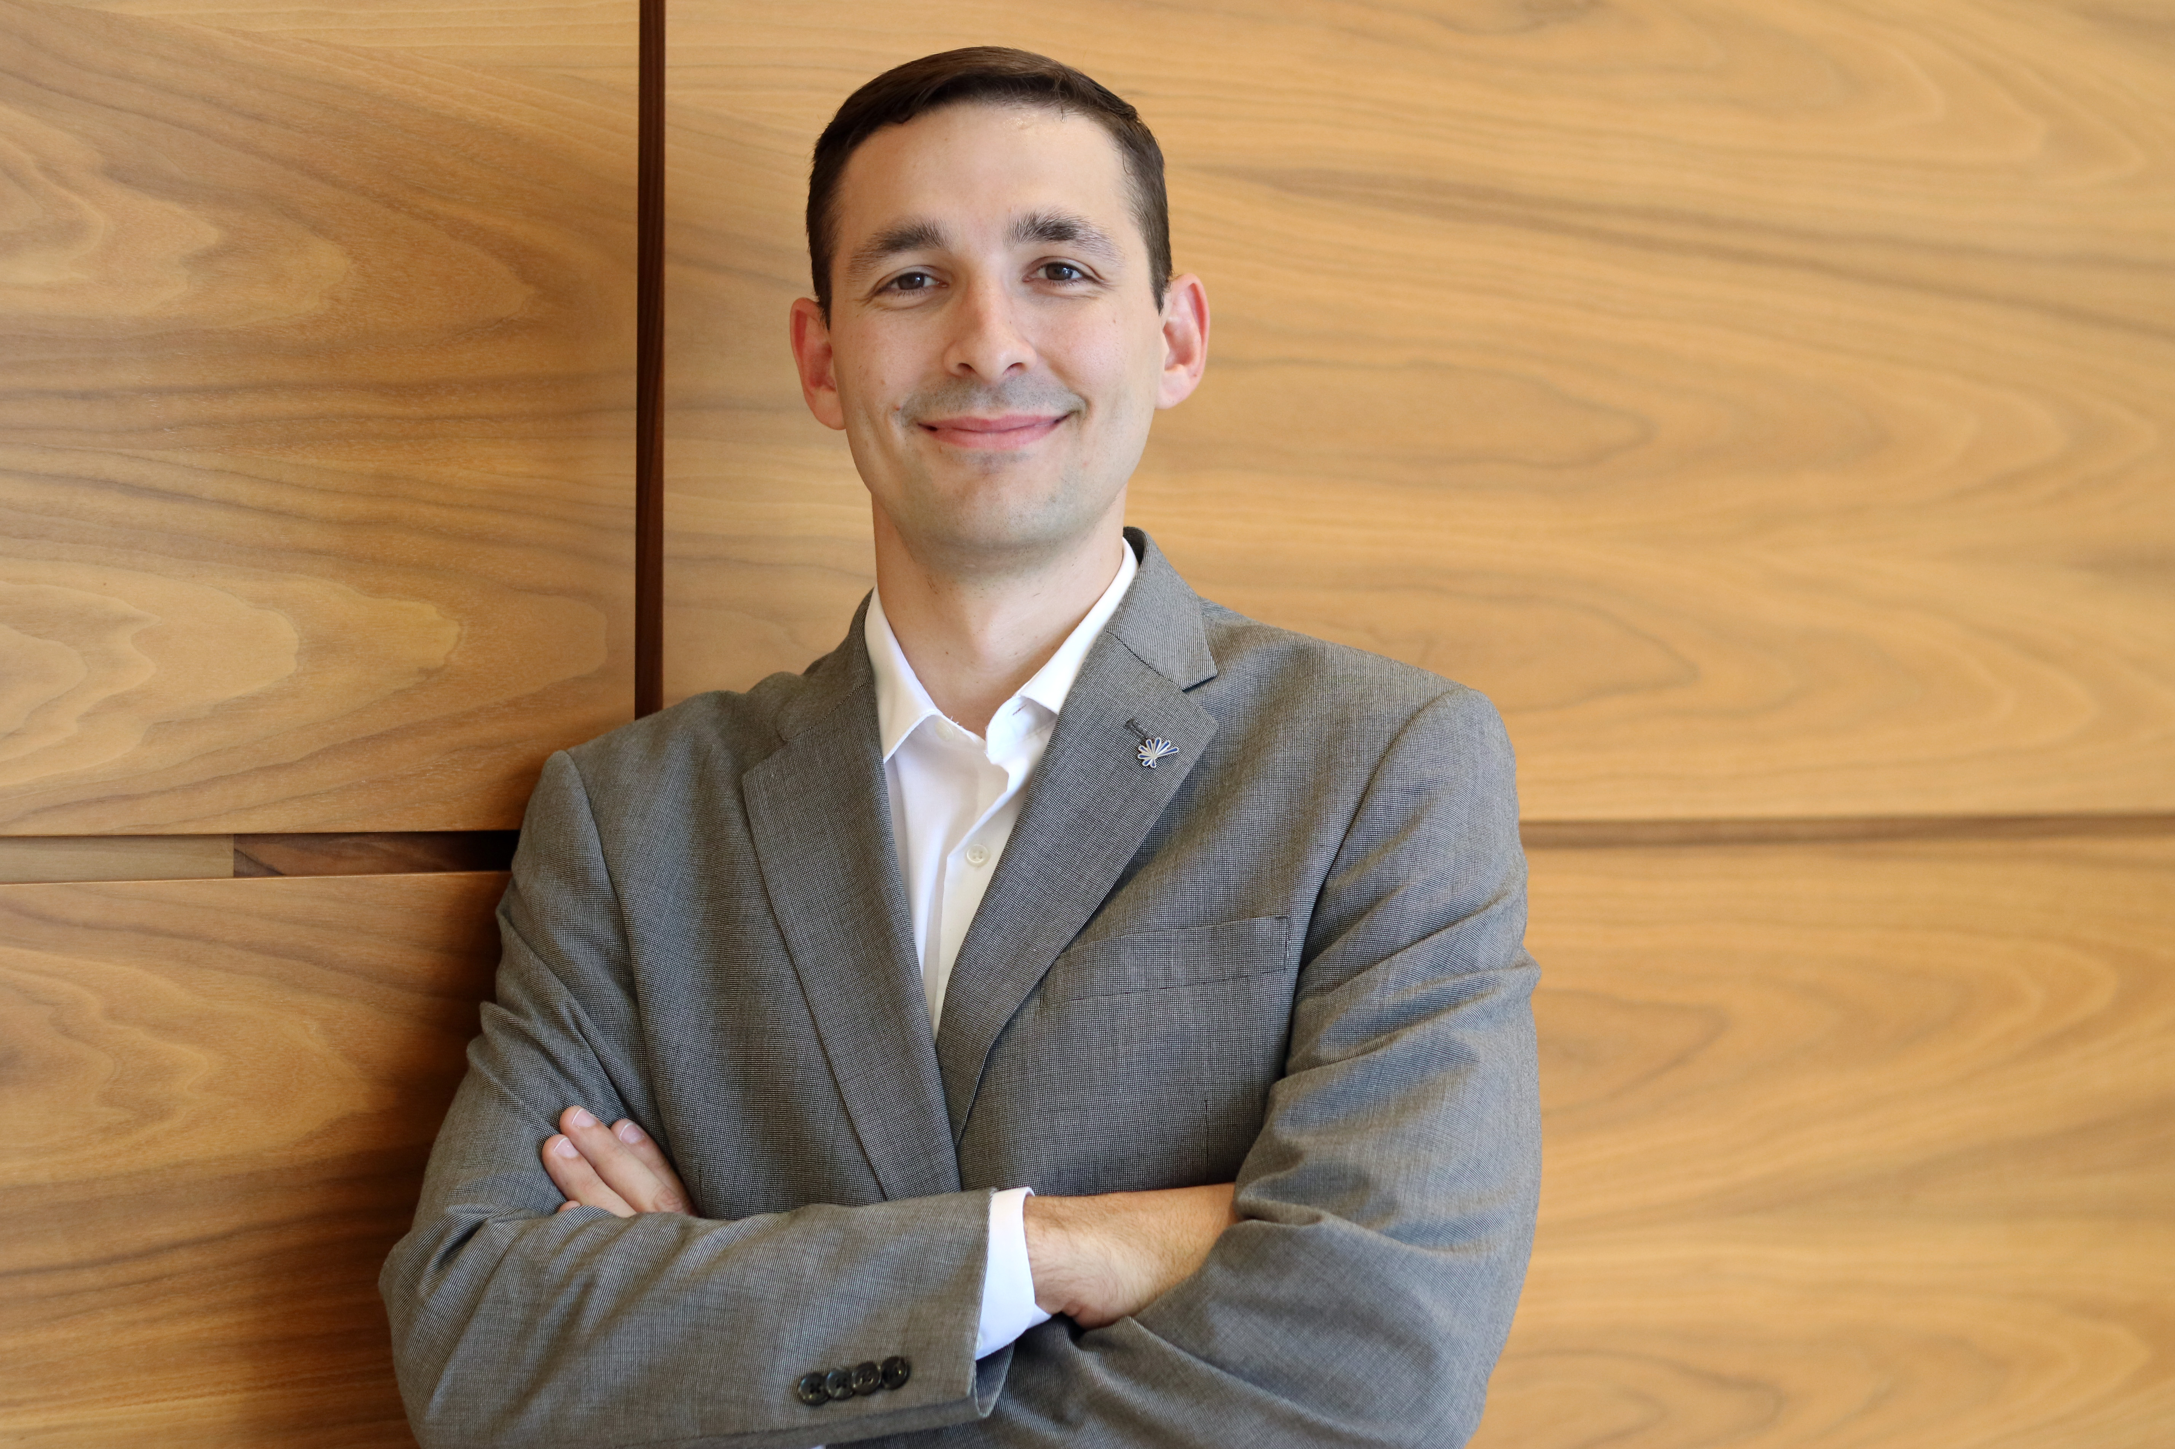
Introductions
Christian
Husband
Father
Passionate Geek
Life long learner

Slide 3
What makes a great developer?
??
Notes:
Be Brilliant at the fundamentals
Know the basics and why they matter

Slide 4

What do we all know?
Notes:
SOLID?
GoF Patterns?
GRASP?
Coupling/Cohesion?
Efferent / Afferent
Single Responsibility Principle (SOLID)
High Cohesion (GRASP)
Low Coupling (GRASP)
Open Closed Principle (SOLID)
Liskov Substitution principle (SOLID)
Interface Segregation Principle (SOLID)
Dependency Inversion Principle (SOLID)
Program to an Interface, not to an Implementation
Hollywood Principle
Polymorphism (GRASP)
Information Expert (GRASP)
Creator (GRASP)
Pure Fabrication (GRASP)
Controller (GRASP)
Favor composition over inheritance
Indirection (GRASP)

Slide 5
Word Soup
SOLID?
GoF Patterns?
GRASP?
Coupling/Cohesion?
Efferent / Afferent
Single Responsibility Principle (SOLID)
High Cohesion (GRASP)
Low Coupling (GRASP)
Open Closed Principle (SOLID)
Liskov Substitution principle (SOLID)
Interface Segregation Principle (SOLID)
Dependency Inversion Principle (SOLID)
Program to an Interface, not to an Implementation
Hollywood Principle
Polymorphism (GRASP)
Information Expert (GRASP)
Creator (GRASP)
Pure Fabrication (GRASP)
Controller (GRASP)
Favor composition over inheritance
Indirection (GRASP)

Slide 6

All analogies breakdown…

Slide 7
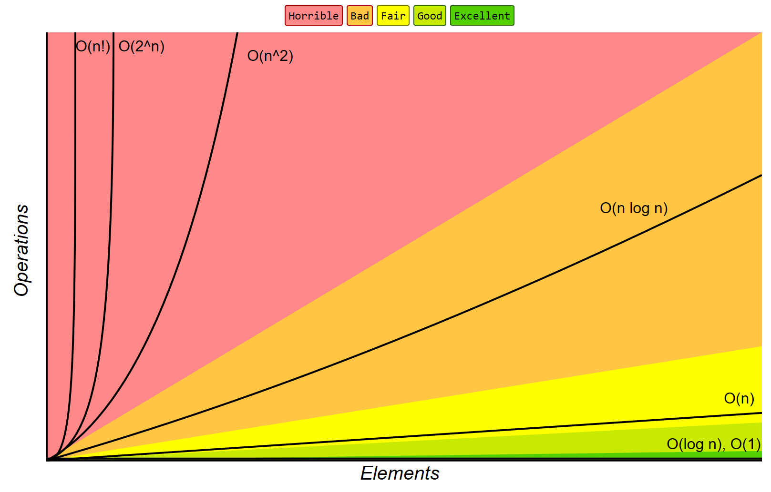
Our biggest problems are our solutions…

Slide 8

Out of the contrived and into…

Slide 9
Code Slide
Peanut butter, Coding Time!

